Slide 1

Probability
EQ – How do I calculate the probability of an expected event?

Slide 2
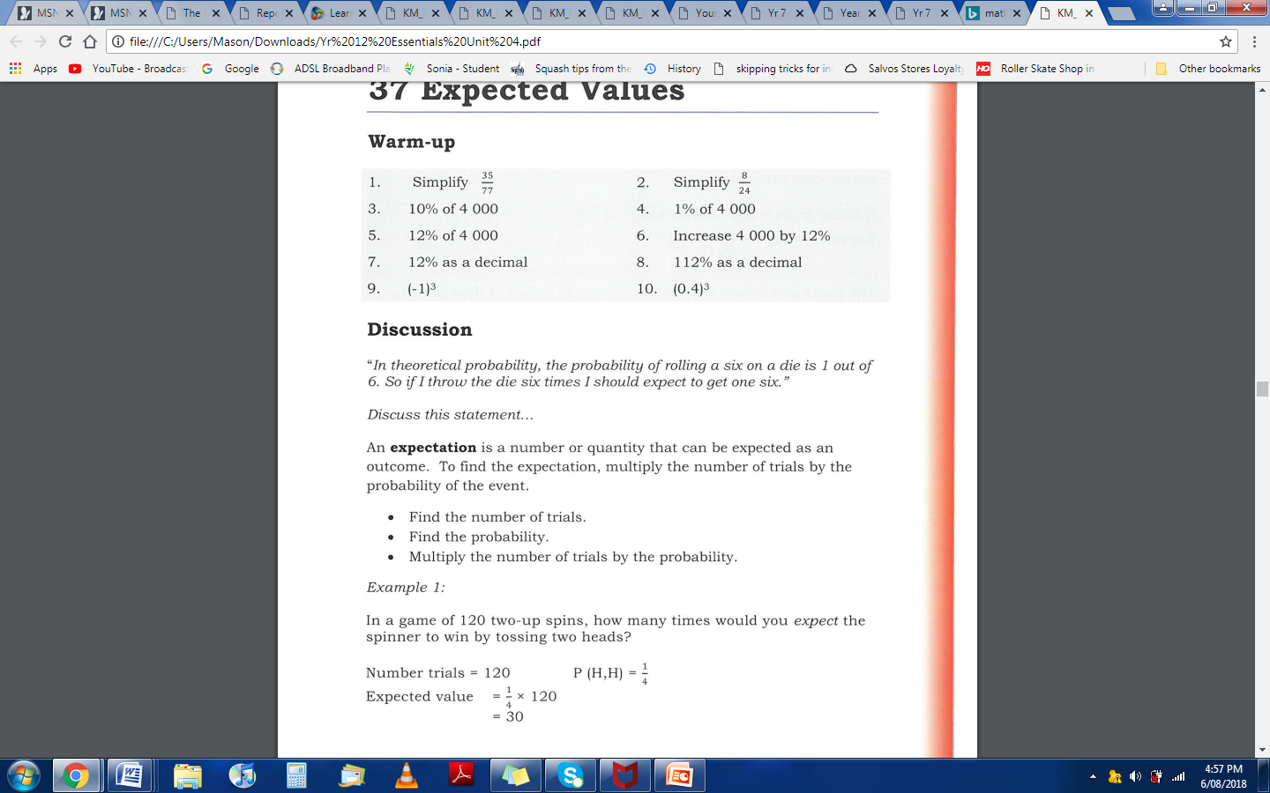
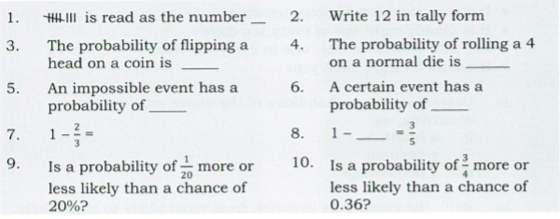


Slide 3
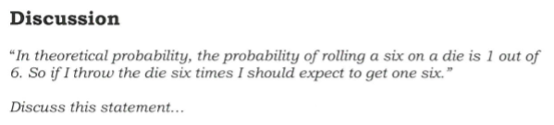
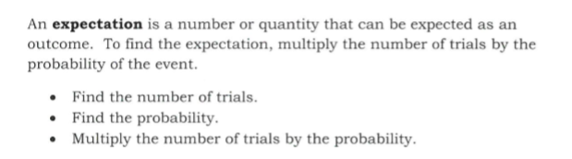
24
7
30
Topic: Expected Values
Date:
EQ – How do I calculate the probability of an expected event?
What is an Expected Value?

Slide 4
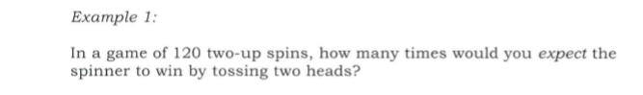


Slide 5
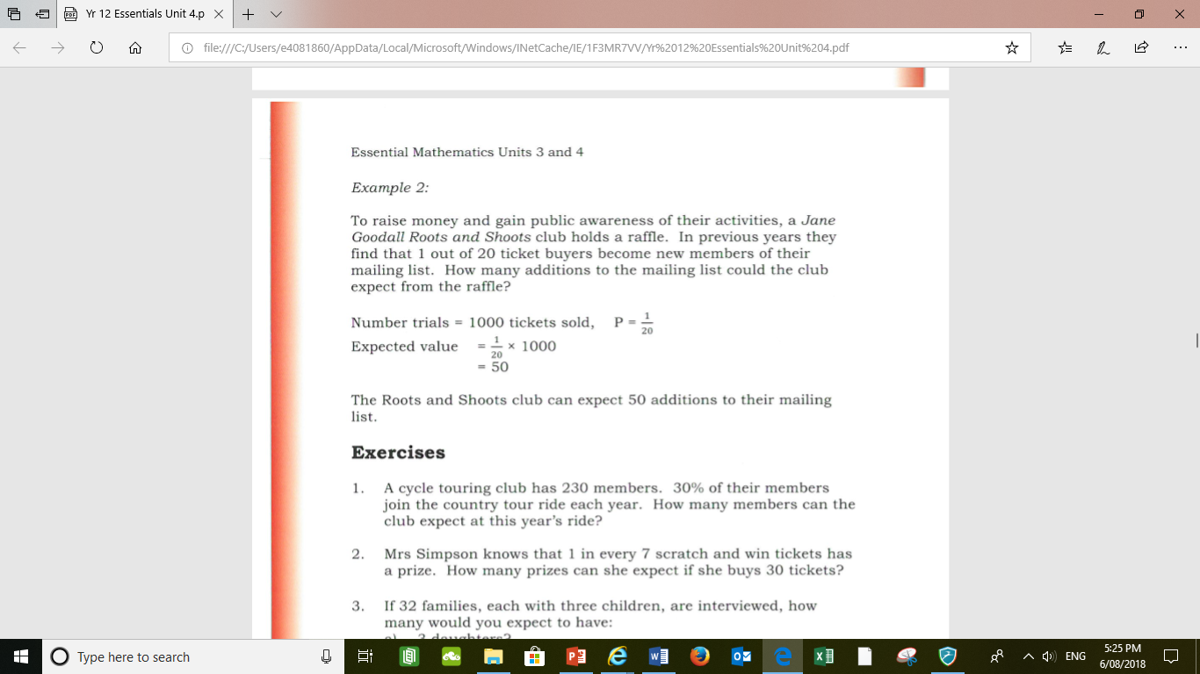

Notes:
Guided practice

Slide 6
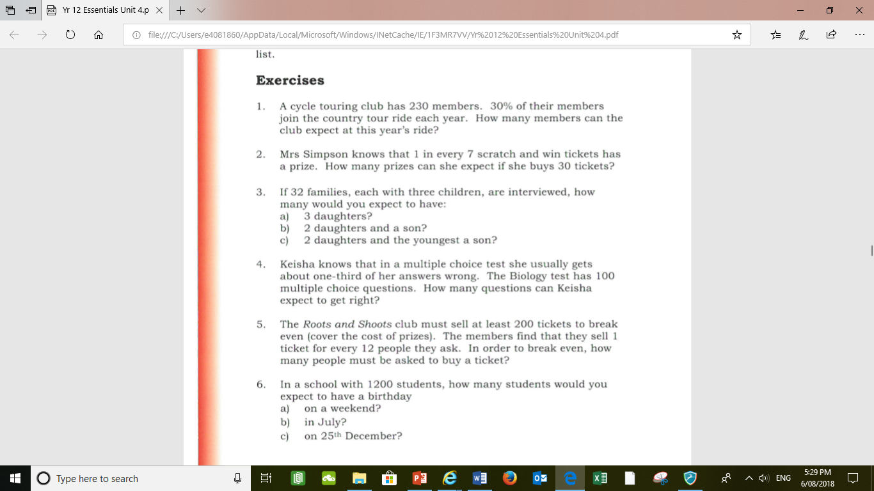
Your turn: Complete this in your Interactive notebook

Slide 7
Your turn: Complete this in your Interactive notebook
Notes:
Guided practice

Slide 8
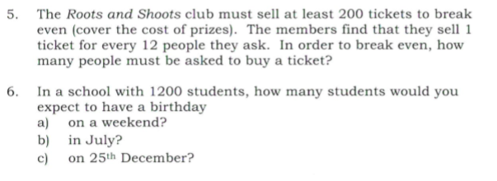
Your turn: Complete this in your Interactive notebook

Slide 9
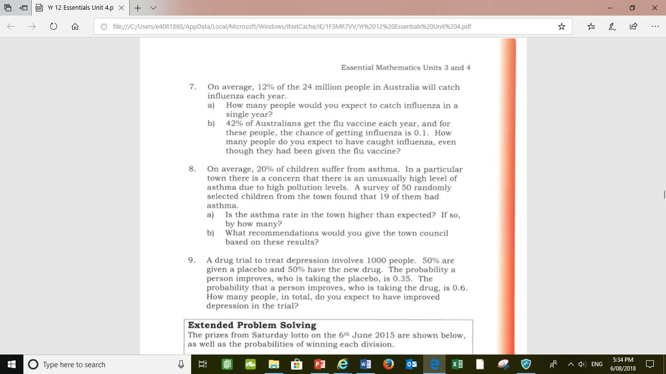

Slide 10
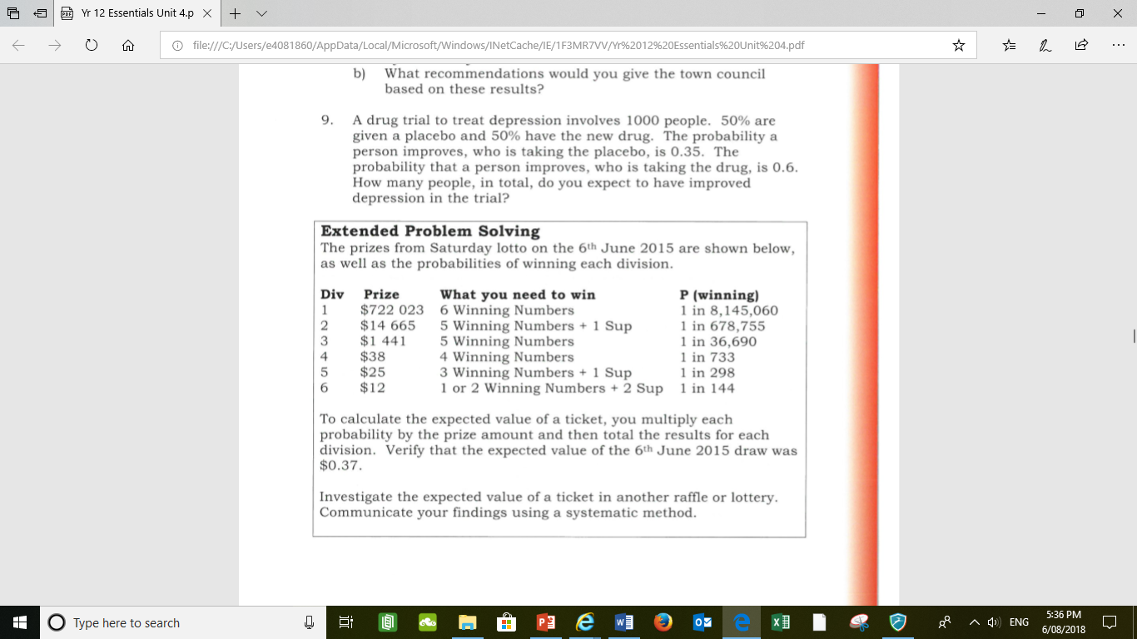

Slide 12


Hope you have a great day
Some memes for you

